Slide 1
“Web Application Maker”: the next 11 years ☺
Miguel Calejo
Declarativa, Portugal http://www.declarativa.com

Slide 2
Agenda for today
Web apps: a different perspective on DRY
Web Application Maker
  Architecture
  The database is (almost) the app
  Meta-model editing with WAMAdmin
  What can WAM do for me?
  Beyond models, into custom coding
Conclusion, and an announcement

Slide 3
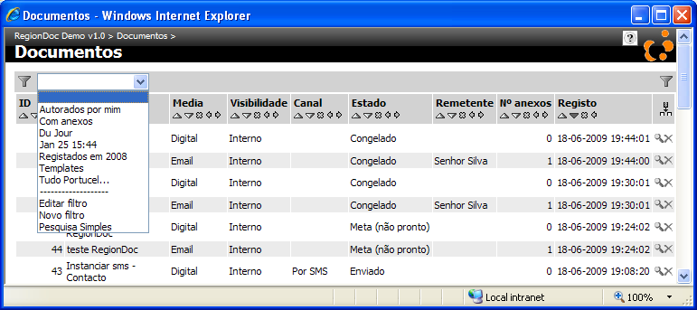
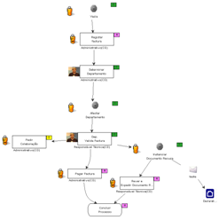

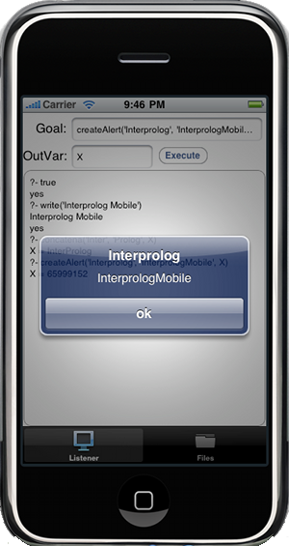
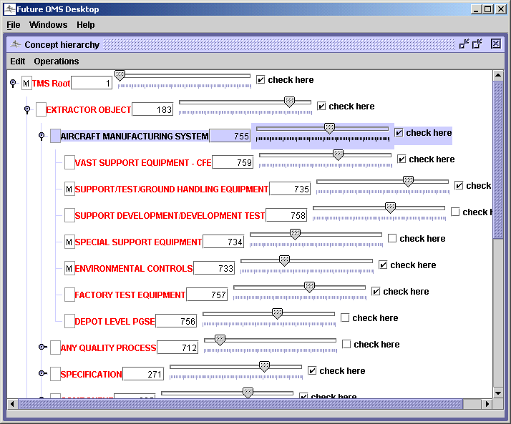
Declarativa: apps... and tools
For SQL developers:
  Web Application Maker
  RegionDoc
For Prolog developers
  InterProlog
    Desktop
    Mobile

Slide 4
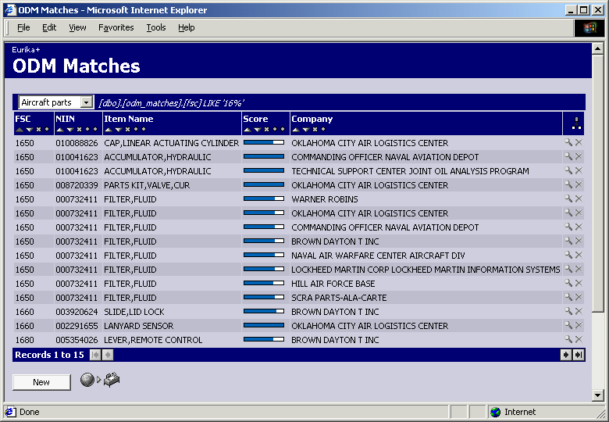
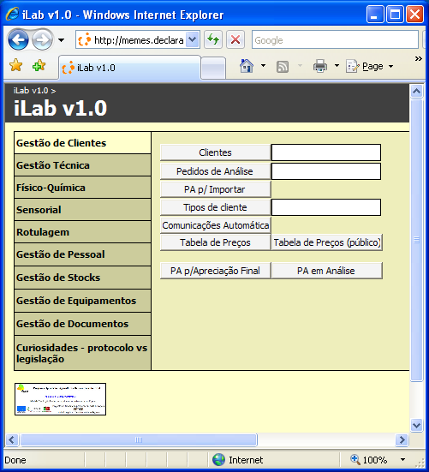

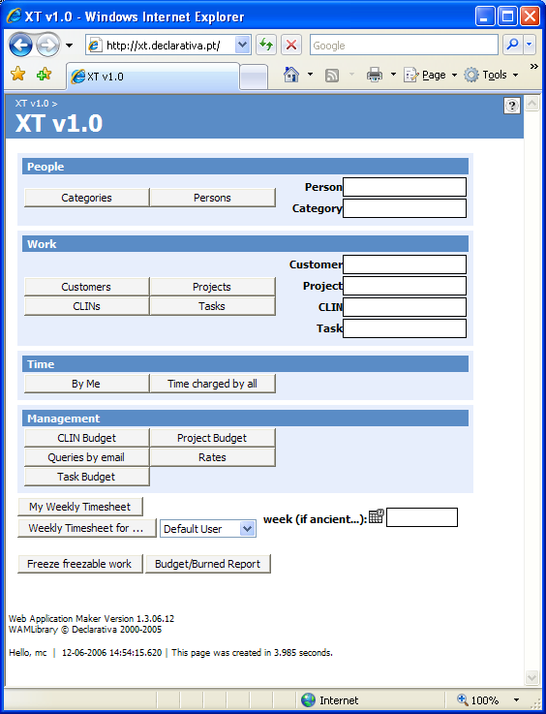



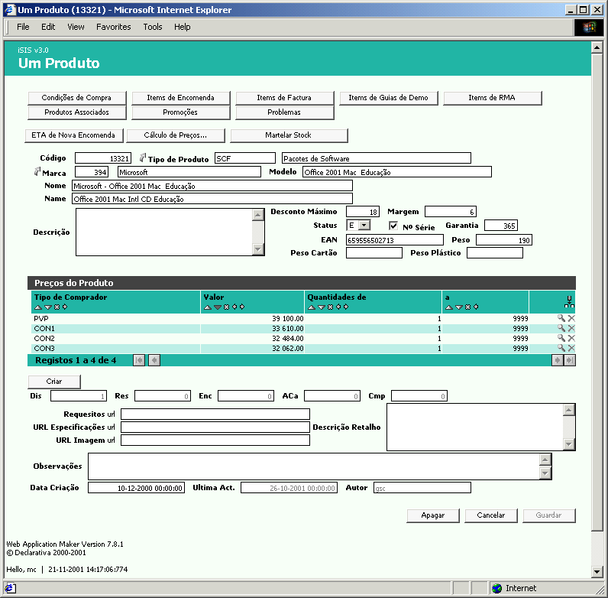
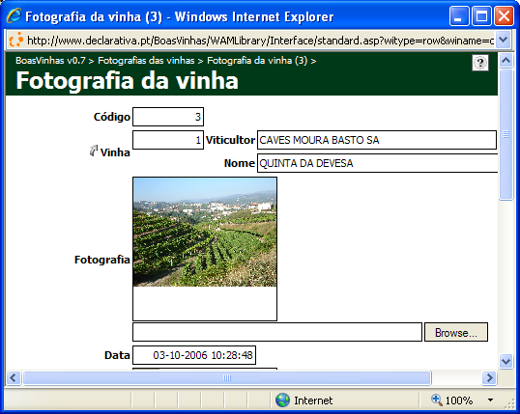

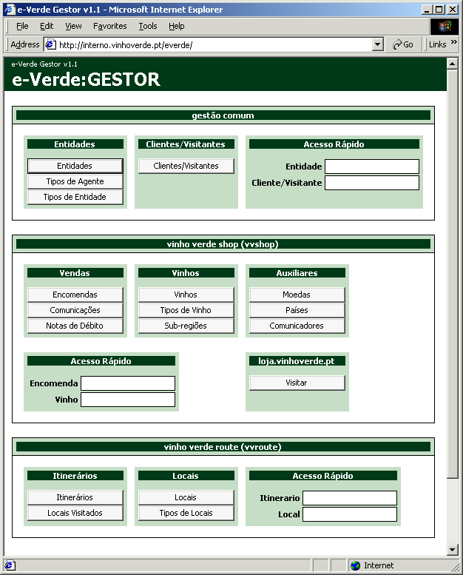

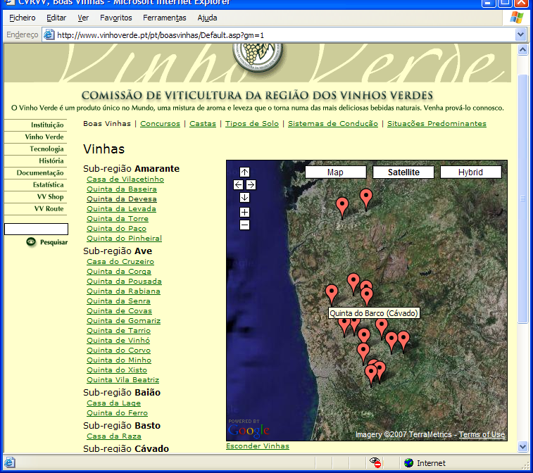


WAM in the real world
> 40 web IS since 2000:
CCDR-N
CVRVV
DoD/DLA (USA)
Environment Agency
Ministry of Economy
RentingPoint
Servisoft
XSB, Inc. (USA)

Slide 5
Agenda for today
Web apps: a different perspective on DRY
Web Application Maker
  Architecture
  The database is (almost) the app
  Meta-model editing with WAMAdmin
  What can WAM do for me?
  Beyond models, into custom coding
Conclusion, and an announcement

Slide 6
Web software development
Web application - a definition:
  Software providing server responses to a set of HTTP URL requests from user browsers
At least 3 software execution layers:
  DB
    Transact-SQL, PL-SQL, ...
  Web (HTTP) server
    JavaScript, VBScript, PHP, Java, Ruby, Python...
  Browser web
    HTML, JavaScript, Flash, Java, …
DRY
  Don’t Repeat Yourself…?

Slide 7
<hype>
Where is the essence of your app?
Yet another model
Java, VB, C#, Perl, Ruby...
Declarative knowledge
Redundancy hard to change
SQL
...and what can this mean for your development?

Slide 8
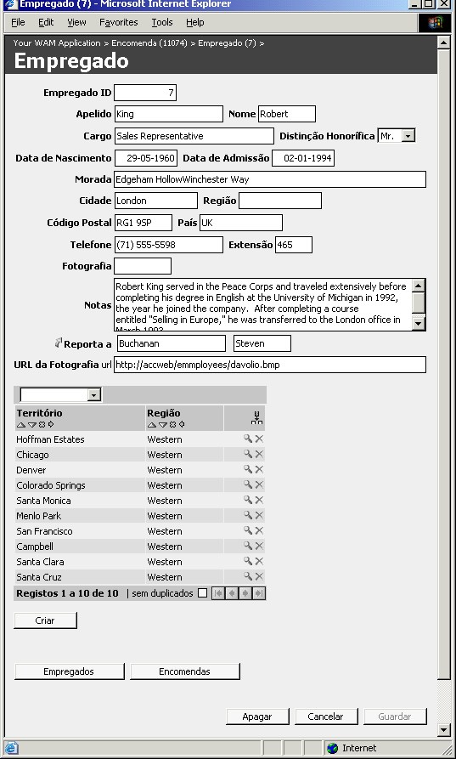
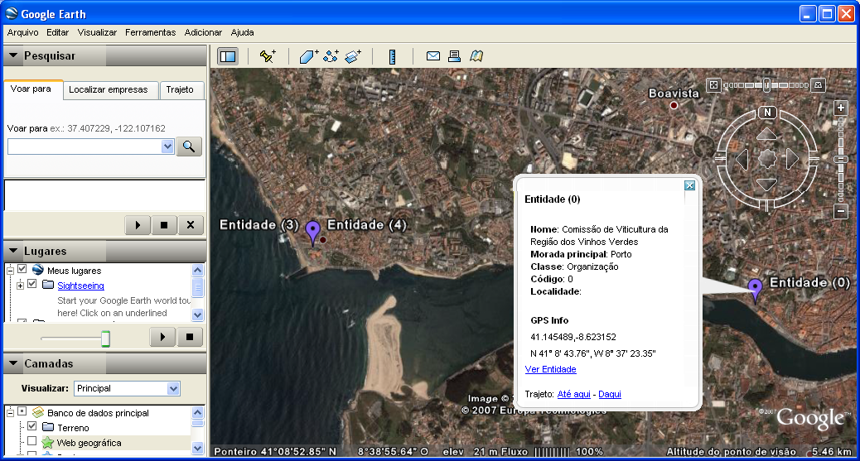
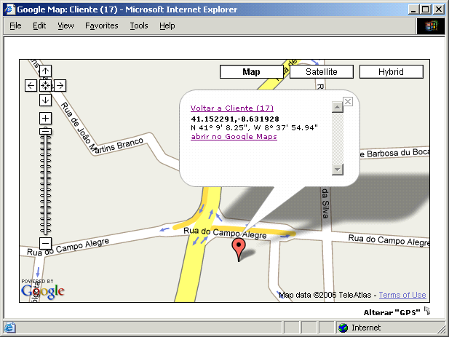
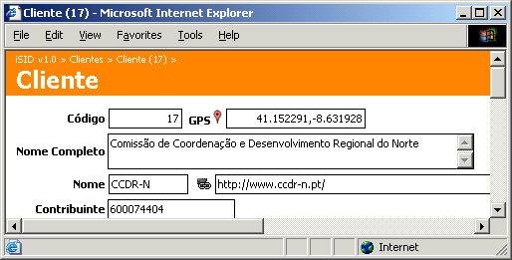
Boost your SQL layer!
Project center is now here
WAM
SQL
Multiple
user
profiles
Database changes not a problem
Zero lines of code, customizable in JavaScript
</hype>

Slide 9
The WAM picture

Slide 10
Agenda for today
Web apps: a different perspective on DRY
Web Application Maker
  Architecture
  The database is (almost) the app
  Meta-model editing with WAMAdmin
  What can WAM do for me?
  Beyond models, into custom coding
Conclusion, and an announcement

Slide 11
Visiting the WAM showroom
Two databases available for experimentation over the web
  Northwind: food stores example
  pubs: books and publishers example
Developing a simple front-end application for the Northwind database, over three versions:
  Northwind (we do nothing – single click and WAM makes it)
  Northwind_B (no code, just WAMmodel editing)
  Northwind_C (SQL user types plus some Javascript)

Slide 12
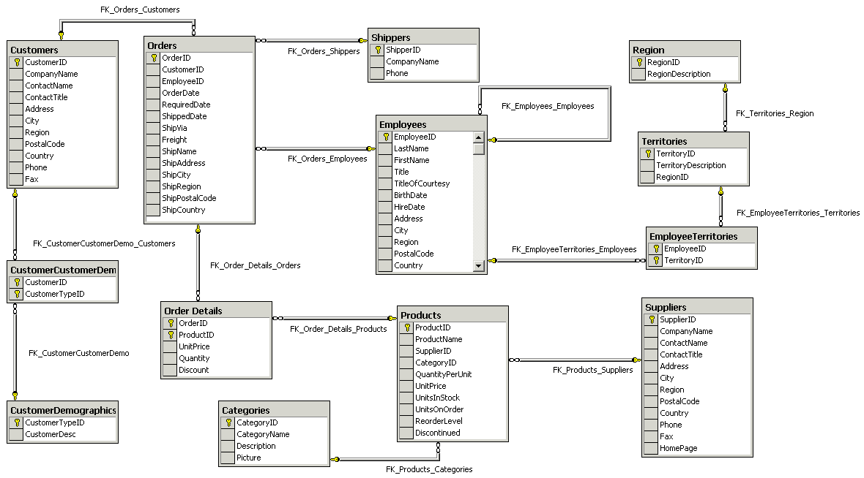
“Northwind” database

Slide 13
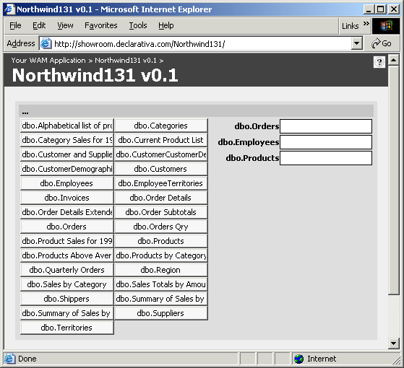
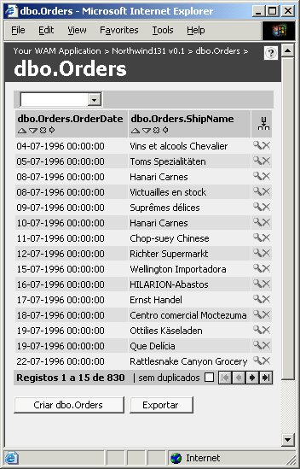
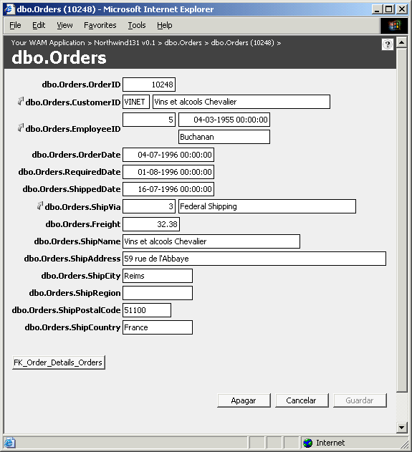
Single click: "vanilla" WAM app

Slide 14
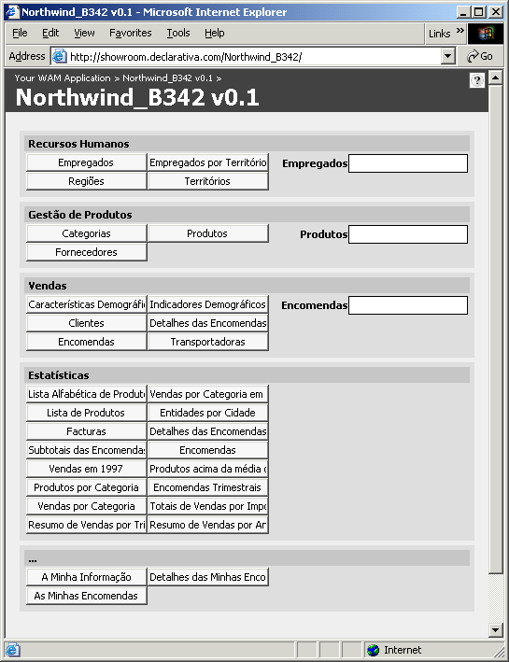
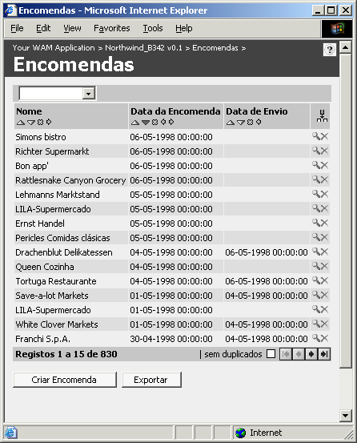
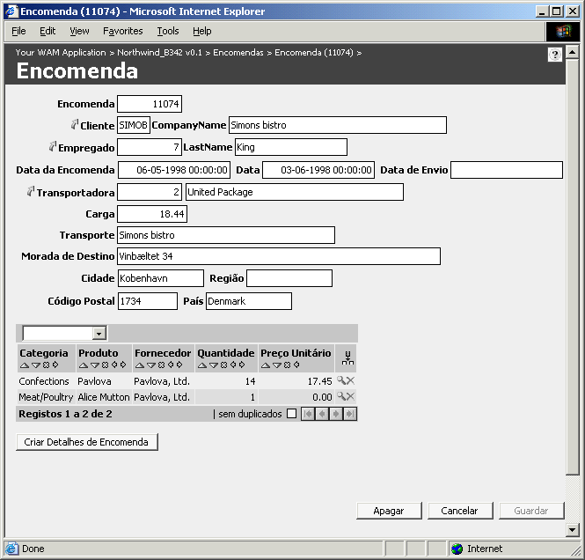
Northwind_B, an hour later

Slide 15
About the WAMmodel
Northwind->Northwind_B: no code
  just WAMmodel editing (can be done over the web)
The WAMmodel is information added to the database to specify a reasonable GUI:
  WAM_PRESENTATION
  WAM_LIST, WAM_LIST_COLUMN
  WAM_LOOKUP_COLUMN
  WAM_PROCEDURE_CALL
  ...a few more SQL tables
Strongly tied to the relational meta-model, but non-redundant (DRY!)

Slide 16
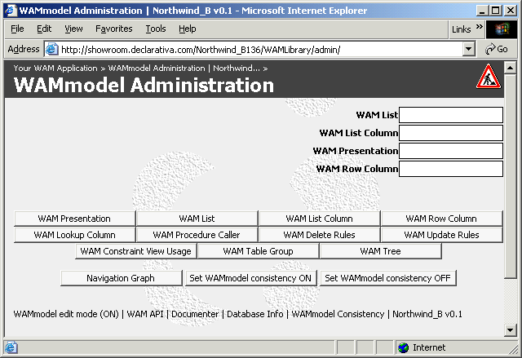
Editing the WAMmodel
With SQL client tools and scripts, or...
WAMAdmin
  A WAM utility available in all user apps
  Standard lists and rows for all WAMmodel tables
  Some utilities
    WAMmodel/DB consistency checking, DB dependency extractor, Documenter, etc.
  Complemented by runtime “edition mode”, adequate for administrators/power users
  Can be tried on examples at http://showroom.declarativa.com

Slide 17
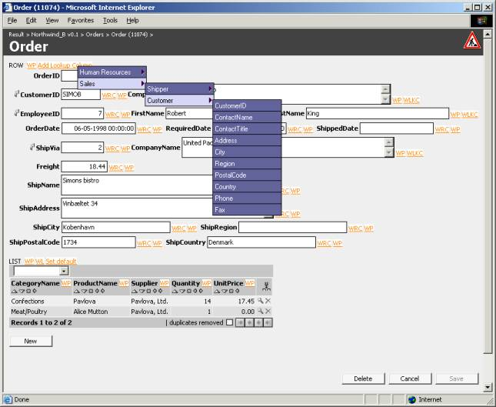
Editing the WAMmodel

Slide 18
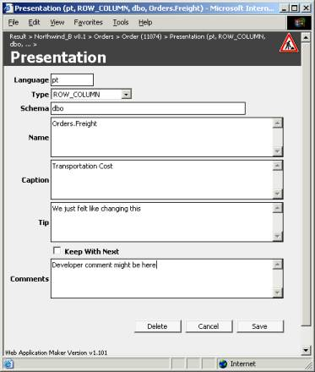
Editing a WAMmodel tuple

Slide 19
Agenda for today
Web apps: a different perspective on DRY
Web Application Maker
  Architecture
  The database is (almost) the app
  Meta-model editing with WAMAdmin
  What can WAM do for me?
  Beyond models, into custom coding
Conclusion, and an announcement

Slide 20
Automated web fragment factory for...
Application entry pages
(Regular) Lists, List columns
Detail lists
  Stand-alone
  Embbeded (in master rows)
Search (SQL) Criteria
Rows, Row fields, Smart Lookup fields
Context path, procedure callers, error reporting
Links to external applications or functionality

Slide 21
Fragment example: lookups

Slide 22
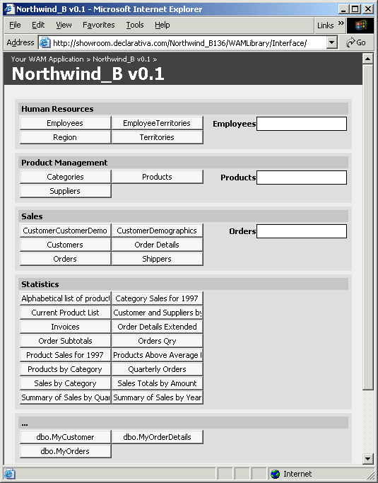
Entry pages
A default entry page, with all lists plus direct navigation to “interesting” tables
Uses WAM_TABLE_GROUP

Slide 23
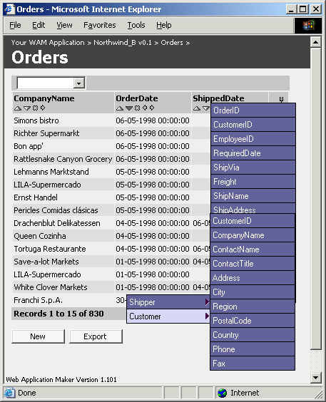
A user-configurable list
Automatic joins, both detail→ master and master → detail
Uses and maintains WAM_LIST, WAM_LIST_COLUMN, WAM_CRITERION

Slide 24
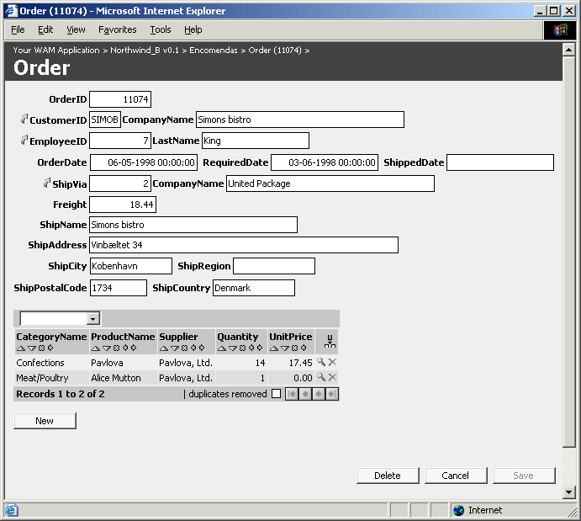
Row with list and 3 LKs

Slide 25
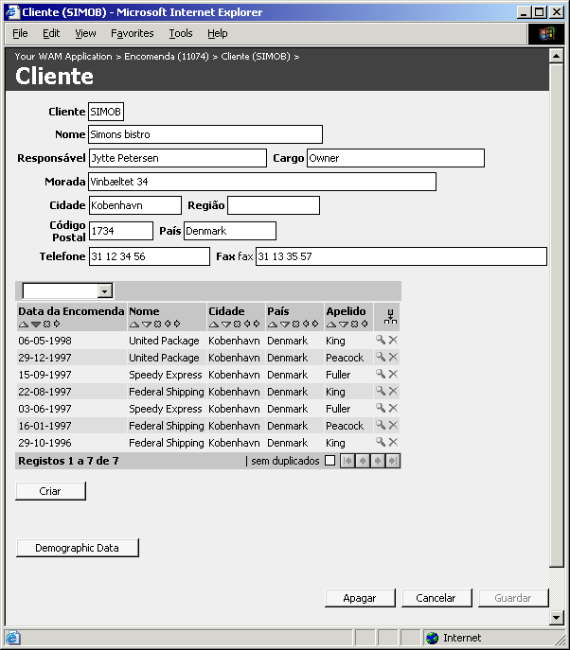
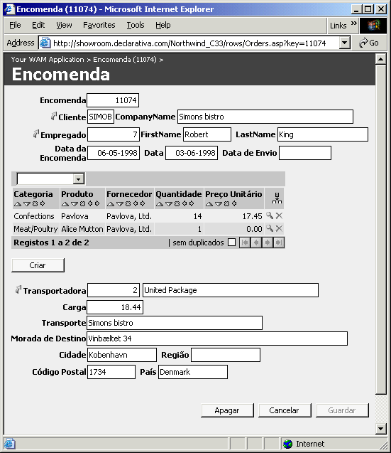
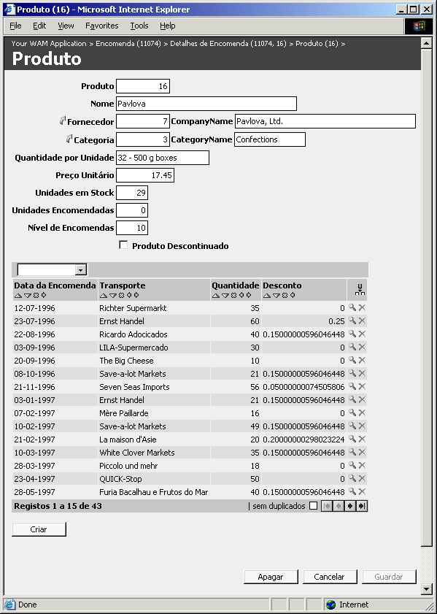
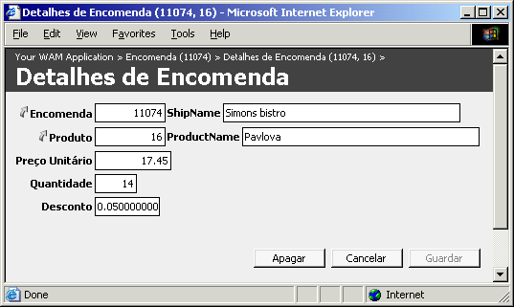
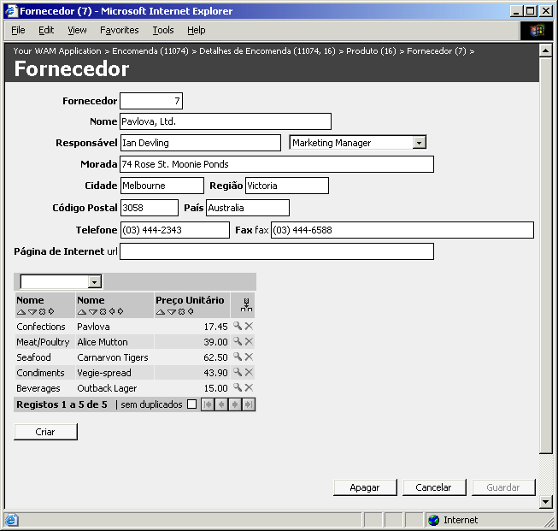
Relational navigation...DRY!

Slide 26
Agenda for today
Web apps: a different perspective on DRY
Web Application Maker
  Architecture
  The database is (almost) the app
  Meta-model editing with WAMAdmin
  What can WAM do for me?
  Beyond models, into custom coding
Conclusion, and an announcement

Slide 27
WAM interface "equations"
Web interface URLs =
WAM(DB Meta Information + WAMmodel)
+ Custom ASP pages using WAM objects
+ other pages
Default web interface =
WAM(DB Meta Inf. + Default WAMmodel)

Slide 28
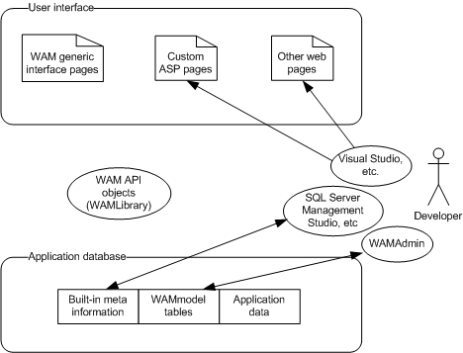
Development with WAM

Slide 29
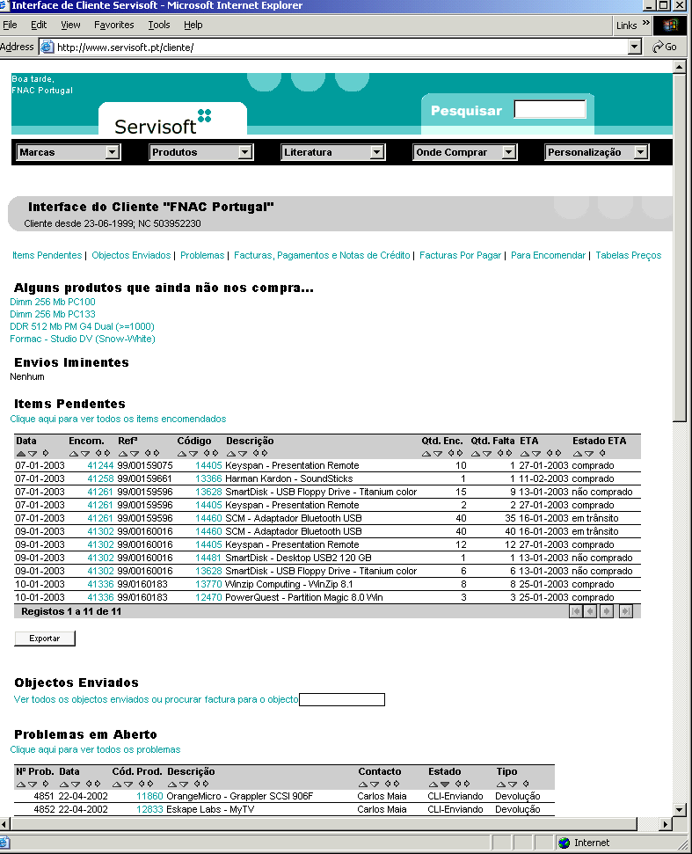
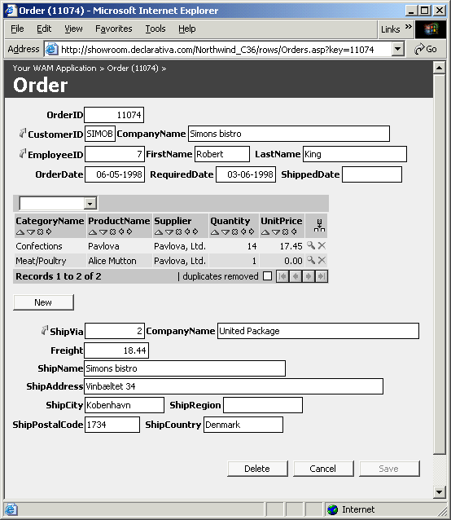
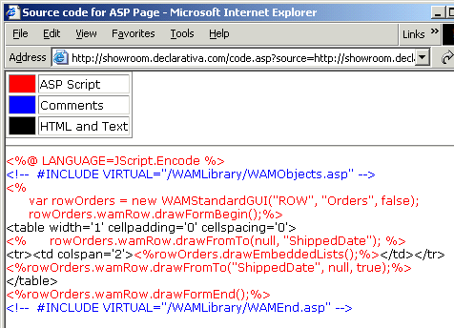
Customized ASPs:WAM API
Single DB dependence. Custom ASP “unbreakable” with DB changes☺

Slide 30
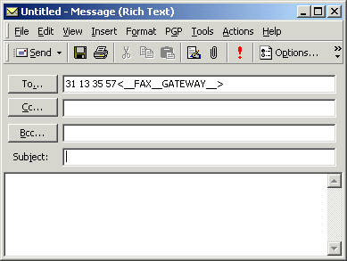
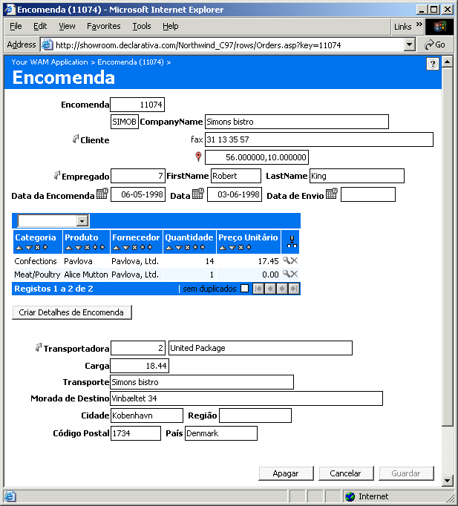
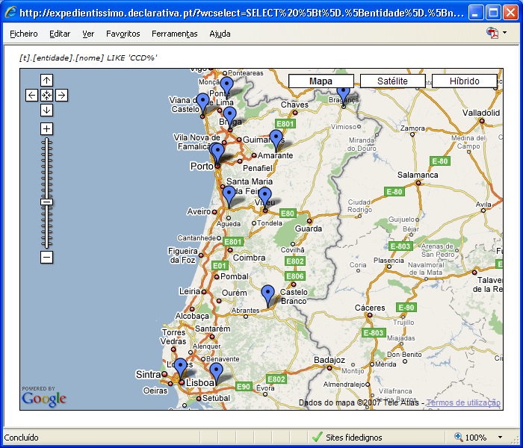
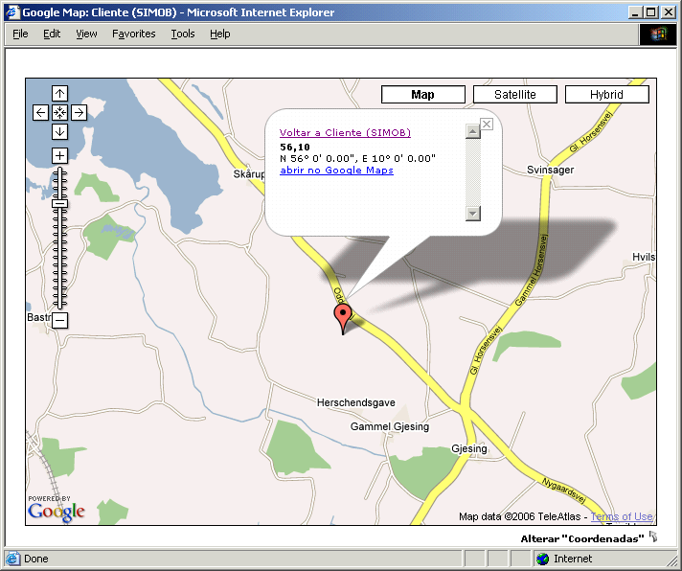
two SQL types and one ASP change later...: Northwind_C

Slide 31
Conclusion…
www.declarativa.pt/wam
  Online showroom
  wamsupport@declarativa.pt
What's needed
  DB layer
    SQL Server 2005/2008 or later
  Web server layer: Windows Pro or Server
    IIS 6.0 or later running
  Browser layer: IE, Firefox, Safari, …

Slide 32

...and the next 11 years...
WAM will be OPEN SOURCE on May, 30!
  Declarative Javascript framework refined over 11 years, +40 real world apps
  DRY system; unique use of FK paths
  SQL Server; Oracle and others possible
Development services community
  Declarativa, Centro de Computação Gráfica, XSB Inc., U.Minho students, ...
Consider using and contributing to it
Suggestions welcome, mc@declarativa.pt

